Slide 1
Overview
It sounds as fraudulent software but presently world is shifting everything towards digitalisation. So, it can be used to monitor employees of a company.
Easy check for the unauthorised access to systems.
Prevents social networking in professional ecosystems.
As a parental Control to keep a check on their children.

Slide 2
Key logger Basic Mechanism
Basically, it records keys pressed by the user
Saves it in a text file.
Gets the status of the keys present on the keyboard
Stealth function in the code is used to make it run in the background.
Timestamp function also shows the time at which the keys are pressed.

Slide 3
Functions Used :
getAsyncKeyState : this function tells whether the key was pressed or not.
getKeyState : retrieves the state of the key
Dest : it’s the pointer to the destination array where the content is to be copied.
Src : this is the string to be copied
writeData : this is the function which writes keys pressed into the text file.

Slide 4
Stealth : this function helps the program to run it in the background.
isKeyListed : it shows mouse and keyboard equivalents for virtual key codes used by the system.
keybd_event: Synthesizes a keystroke. The system can use such a synthesized keystroke. The keyboard driver's interrupt handler calls the keybd_event function.
VK_SNAPSHOT: Synthesizes the printscreen key
VK_LWIN: Synthesizes the left window key

Slide 5
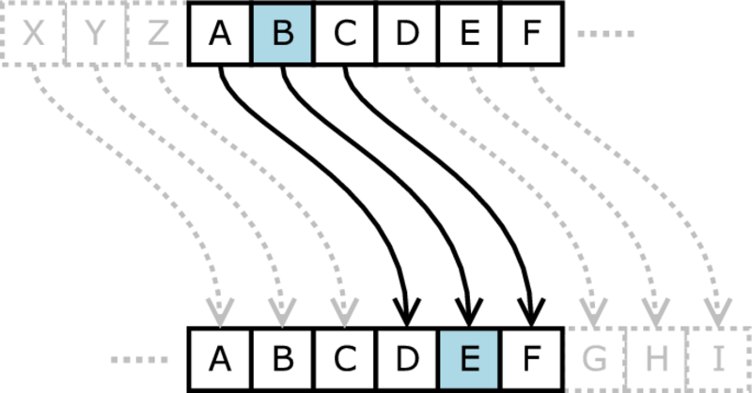
Encryption
Shift Cipher is a type of substitution cipher in which each letter in the plaintext is replaced by a letter at some fixed number of positions down the alphabets.
For Eg : Left shift of D would be replaced by A, E would become B and so on.

Slide 6
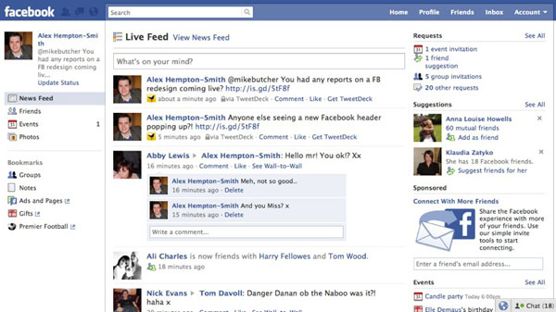
Screenshot
A screenshot is also taken so as to see what the victim is trying to do on the machine.

